Slide 1

Luke’s 2022 Motivation & Toolbox
A description of the tools at my immediate disposal & ideas for productive use.

Slide 2
Basic Motivation
2022
Fear of Humanity Dying in Great Filters
2023
Hope to Be Wealthy, Healthy and Free
to Travel the World Regularly for Work+Fun
Fear of Massive Success Going Out of Control
2024
Fear Consequences of Unknown Unknowns
Hope to Be World Known and Appreciated
for Inspiring Joyful Responsible Abundance
Hope to Be Trusted, Loved and Happy
within Responsible Non-Monogamy

Slide 3
Objective Reasons for tool acquisition
Build an Avatar
Build an Aura
Build a Mind Palace
Build an App Integrated with a Blockchain
Build a Cinematic Universe Narrative
Build Some Epic New Companies
Build Dedicated Server(s)
Make a Great Song
Make a Great Album
Make an Art Gallery
Freedom to Be Me
Freedom to Love and Be Loved
Freedom to Travel When and Where I Wish
Freedom to Create What I Wish
Convenience of On-Demand Visas
Convenience of On-Demand Knowledge
Convenience of Action Without Want of Money
Convenience of Immediate Trustworthy Intelligence
Convenience of a Personalized Home and Workshop
Convenience of Near Instant Global Transport

Slide 4
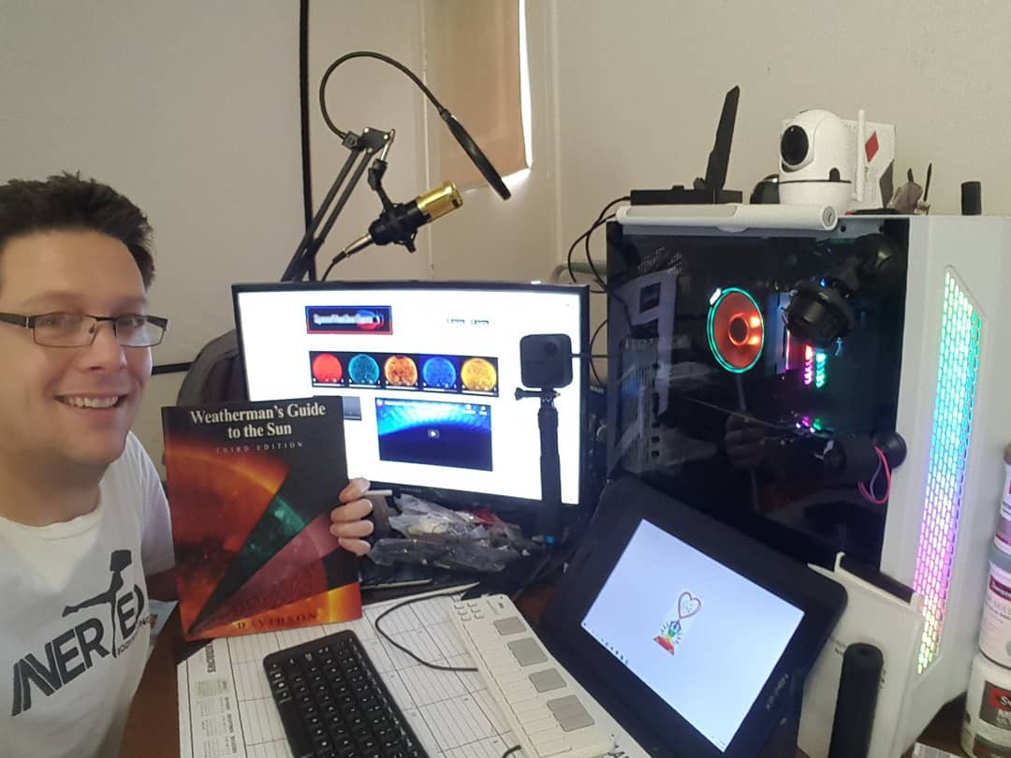
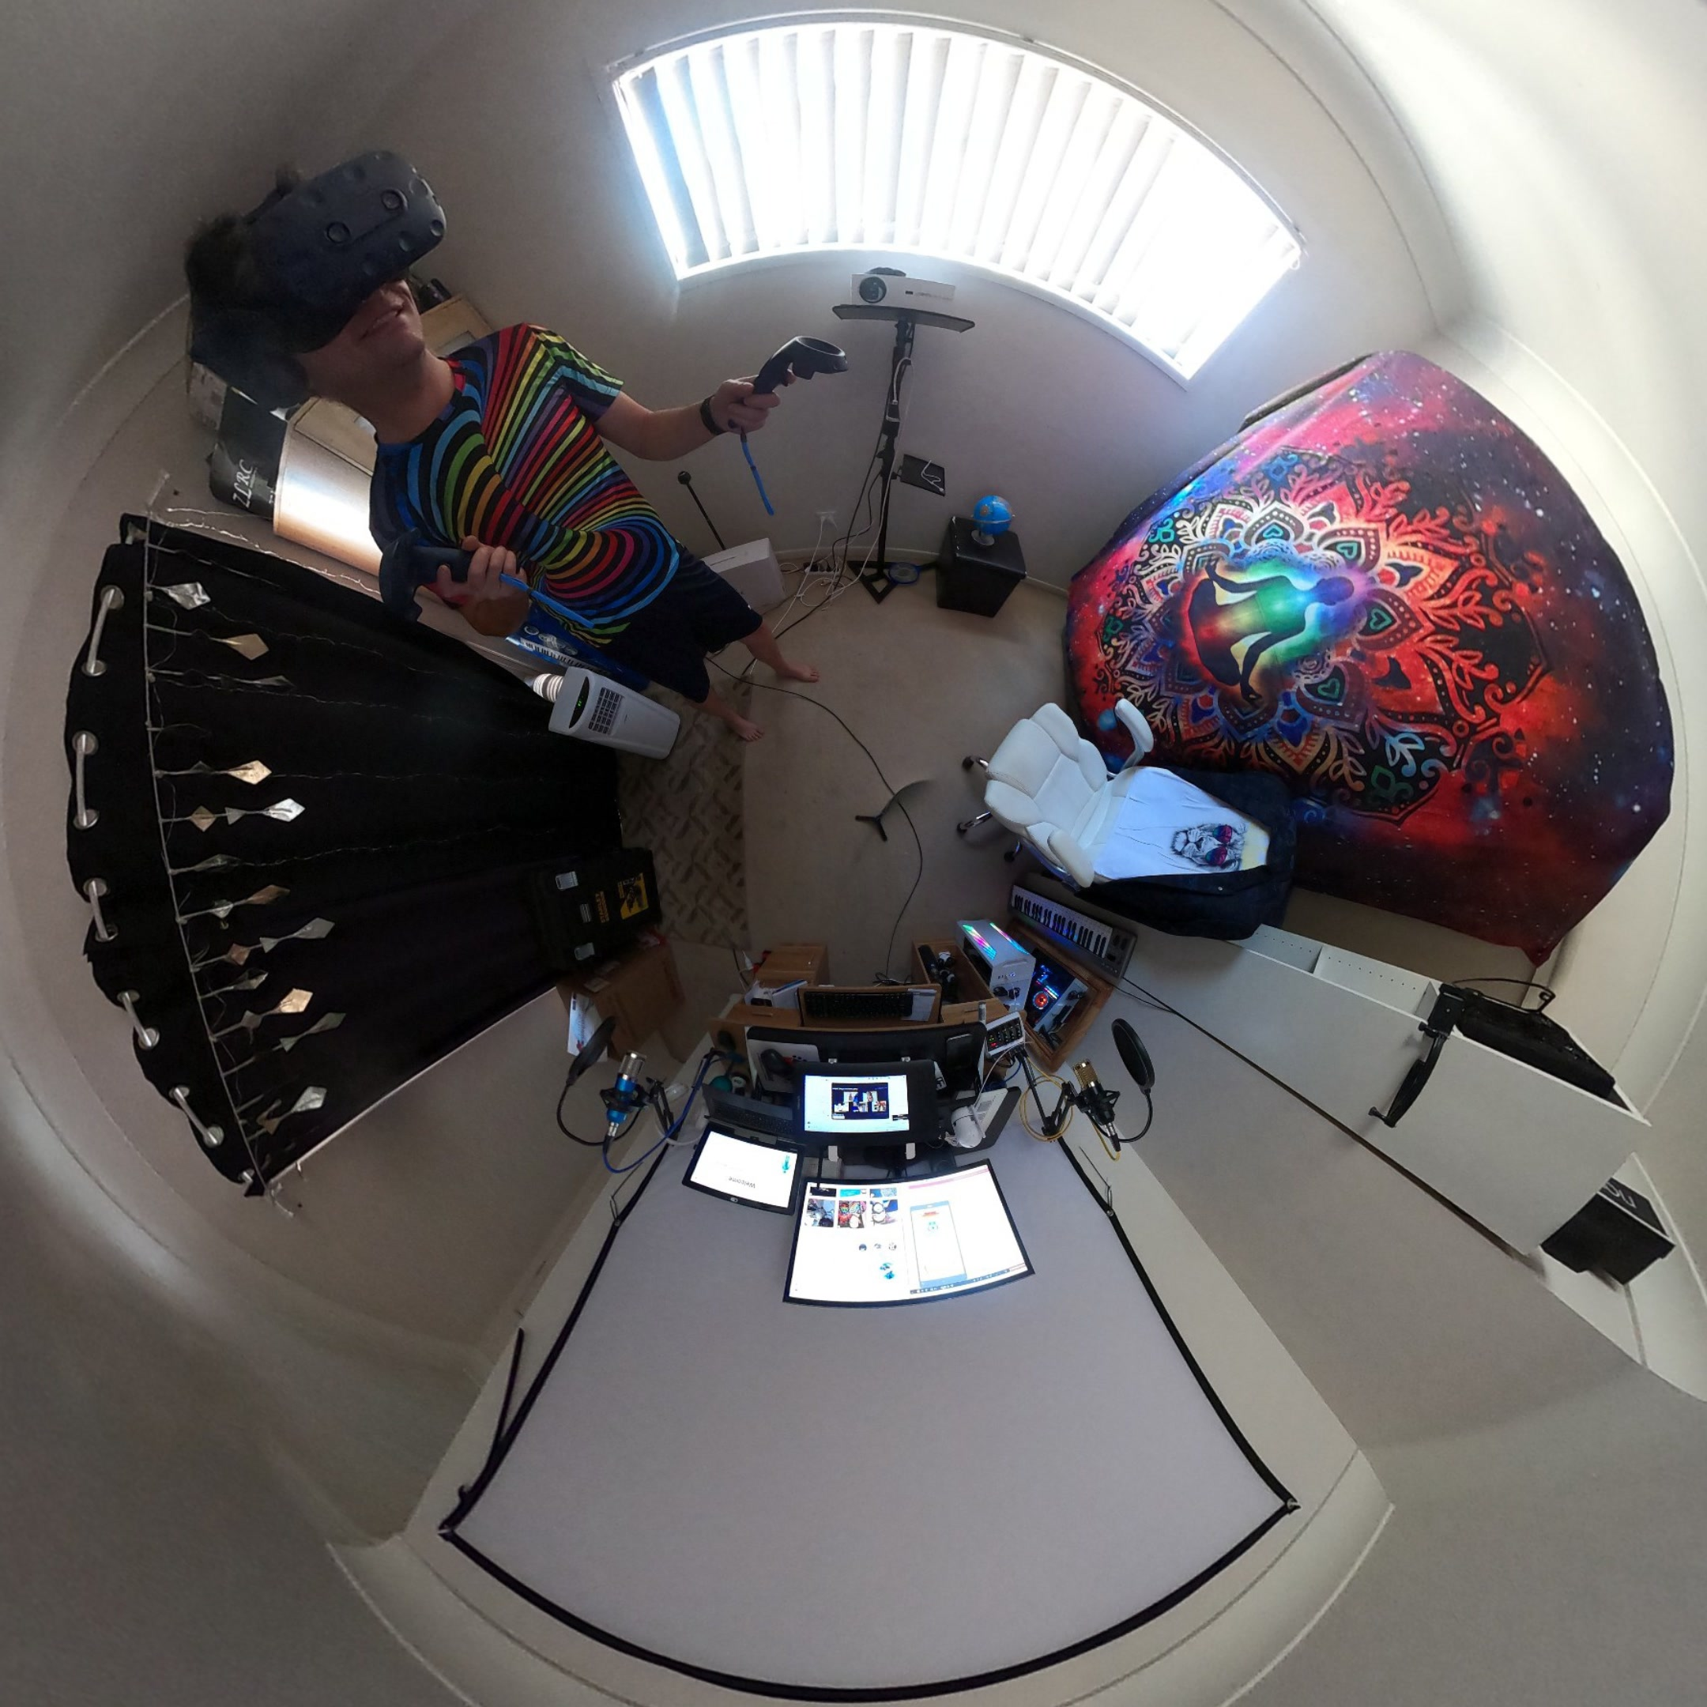
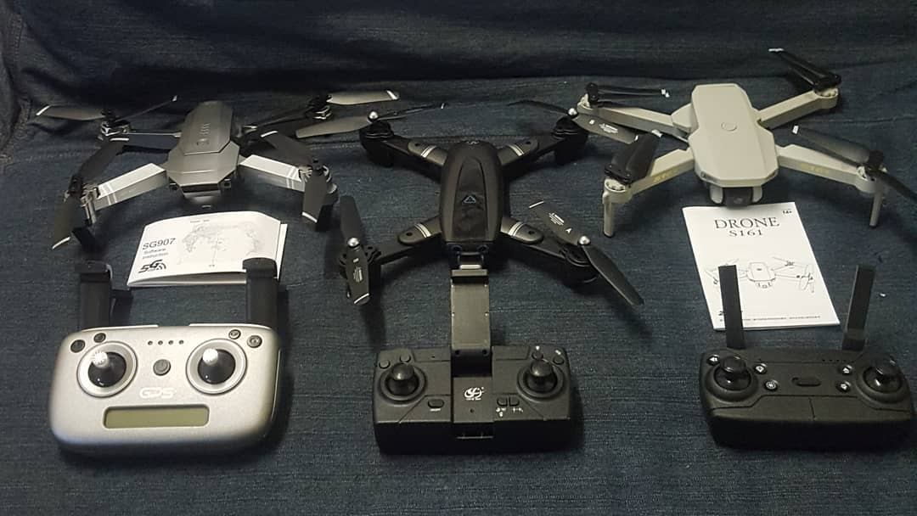
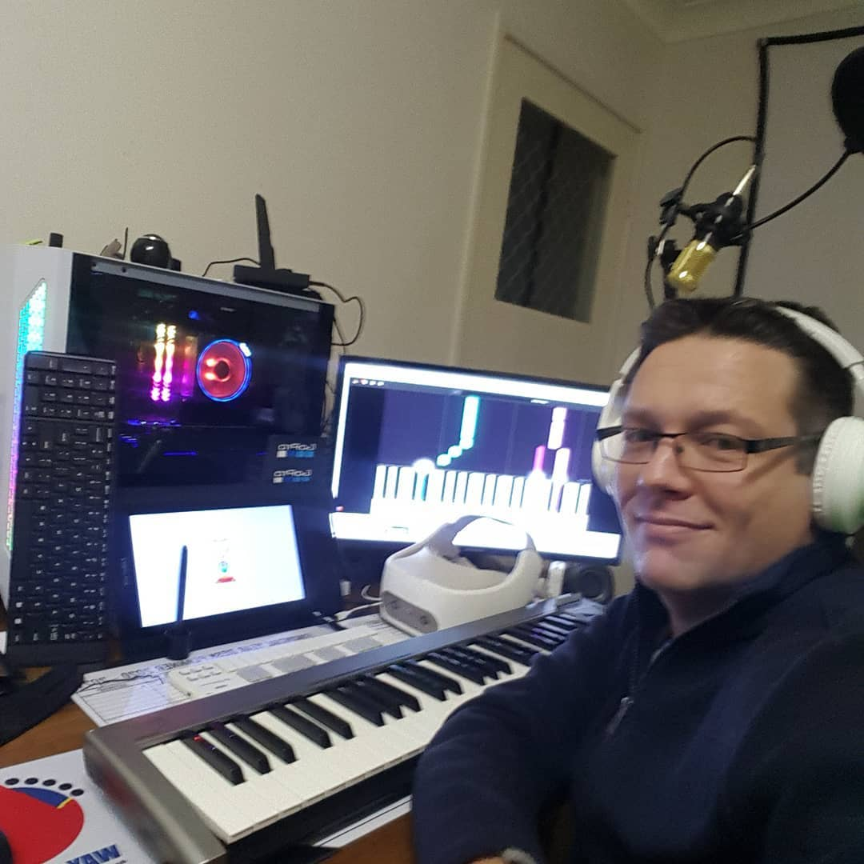
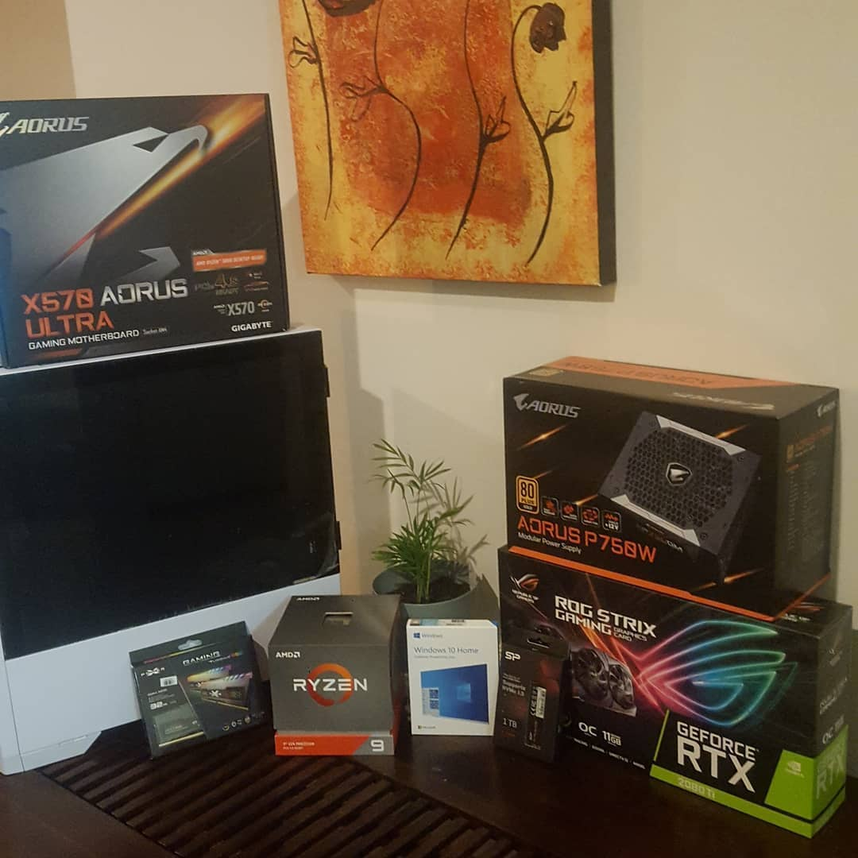
THE COMPUTER HARDWARE
Purchased in 2020 with my early release of superannuation

Slide 5
Hardware Page 1
The Beating Heart
The Eyes and Hands
Ryzen 9 3900X CPU; 12 core 24 threads, 3.79GHz
GeForce RTX 2080Ti GPU; 11Gb, 4K, RT Ray Tracing
64Gb RAM (4 x 16Gb); RGB DDR4 3200MHz CL16
2x1 Tb M.2 NVMe SSD PCIe; R/W 3,400/3,000 MB/s
7 Tb External Hard Drive Memory Capacity
3 Keyboards, 2 being customized with Macros
Wireless Mouse & HP Printer
Samsung 25’’ 60Hz Curved + 22” Flat Monitor
XP-Pen Artist 12; 11.6’’ FHD display 8192 Pen Levels
Vive Pro Virtual Reality Headset Kit
Vive Focus Standalone Virtual Reality Headset Kit
AUN Full HD Light Projector
GoProMAX 5.6K 360º Virtual Reality Action Camera
PanoCam 180º Virtual Reality Action Camera

Slide 6
Hardware Page 2
Mobile Add-ons
The Voice
Samsung S9 128Gb & iPhone XR 128Gb Smartphones
Toshiba Z10t Windows Tablet/Laptop
NeoRhythm Brain Stimulator & Muse S Brain Sensor
Fitbit Versa 2
Huxley 49 Key Keyboard and Midi Controller
Korg NanoKey2 Midi Controller
2 Basic Computer Speakers
The Wings
The Ears
Stabilized Camera Drone
Stabilized Camera Drone
Stabilized Camera Drone
Wireless Lapel Microphone
Wireless Headphones with Microphone

Slide 7
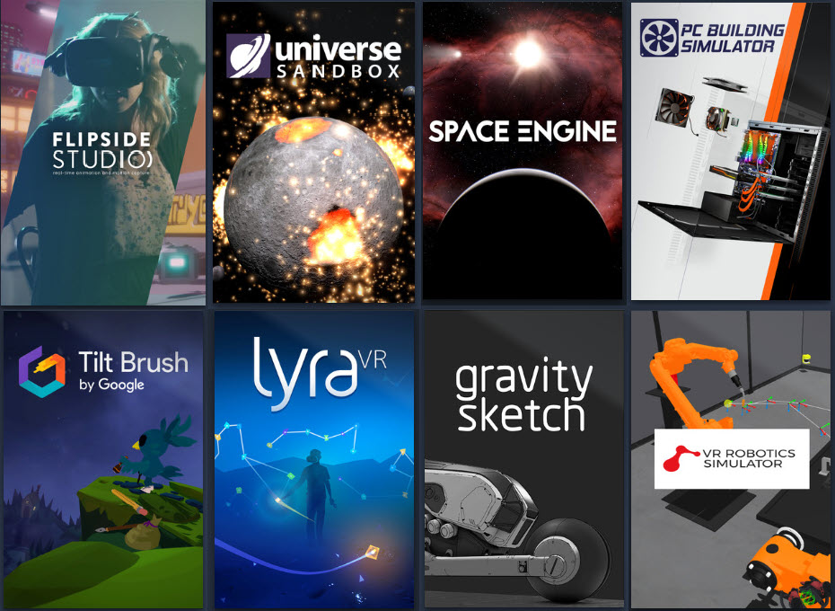


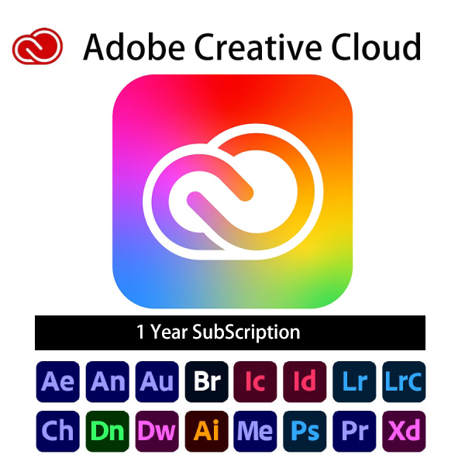

THE COMPUTER software
Currently Active as at April 2022

Slide 8
Software Page 1
Freeware/Freelancer Licence Software
Subscription Software
Unity
Unreal Engine
Autodesk Suite
Blender
Lumberyard
Wolfram Engine
Omniverse
OBS
DaVinci Resolve
Fairlight
X/Split
Audacity
Studio One 4
CUDA
Discord
Telegram
Sketchable
PureRef
Android Studio
Anaconda
Kali Linux
Adobe Creative Cloud
Microsoft Office 365
Autodesk Desktop Suite

Slide 9
Software Page 2
Virtual Reality Software Tools and Environments
Steam VR
Viveport
Google Earth
Tilt Brush
Gravity Sketch
MasterpieceVR
Simmetri
Sansar
MindMapVR
VR Chat
VeeR VR
Work in VR
VR Toolbox
VR Model Viewer
MixCast
Flipside Studio
Strata InStudioVR
LyraVR
vBuilder
Vector Field Painter
Universe Sandbox
Space Engine
Nanome
VR Robotics Sim
Primitive
Lux VR

Slide 10
Software Page 3
Purchased Software
Open Source Machine Learning Algorithms
Simmetri
iClone 7
Character Creator 3
Cartoon Animator 4
The Sims 4
Democracy 3
Cities: Skylines
Universe Sandbox
PC Building Sim
Google Tilt Brush
Solar System Scope
Space Engine Pro
No Man’s Sky
VMWare Workstation Pro
A little bit of this
To be honest it’s still a bit secret but I test the common public frameworks.
A little bit of that
The real deal is still not assembled even though it is 3 years old in my mind.

Slide 11
Software to Develop or Buy
Virtual Reality Software Wish List
Public Talk Trainer
2nd Language Trainer
Every Instrument
Capsule Hotel
Human Body Sim
3D Print My Organs
The Sims 4+ in VR
Social Engineering
Aura of Intelligence
Micro Fluidics
Micro Biome
DNA/RNA
Farm Simulator
Roof Garden Sim
Robotic Gardener
Food Computer

Slide 12

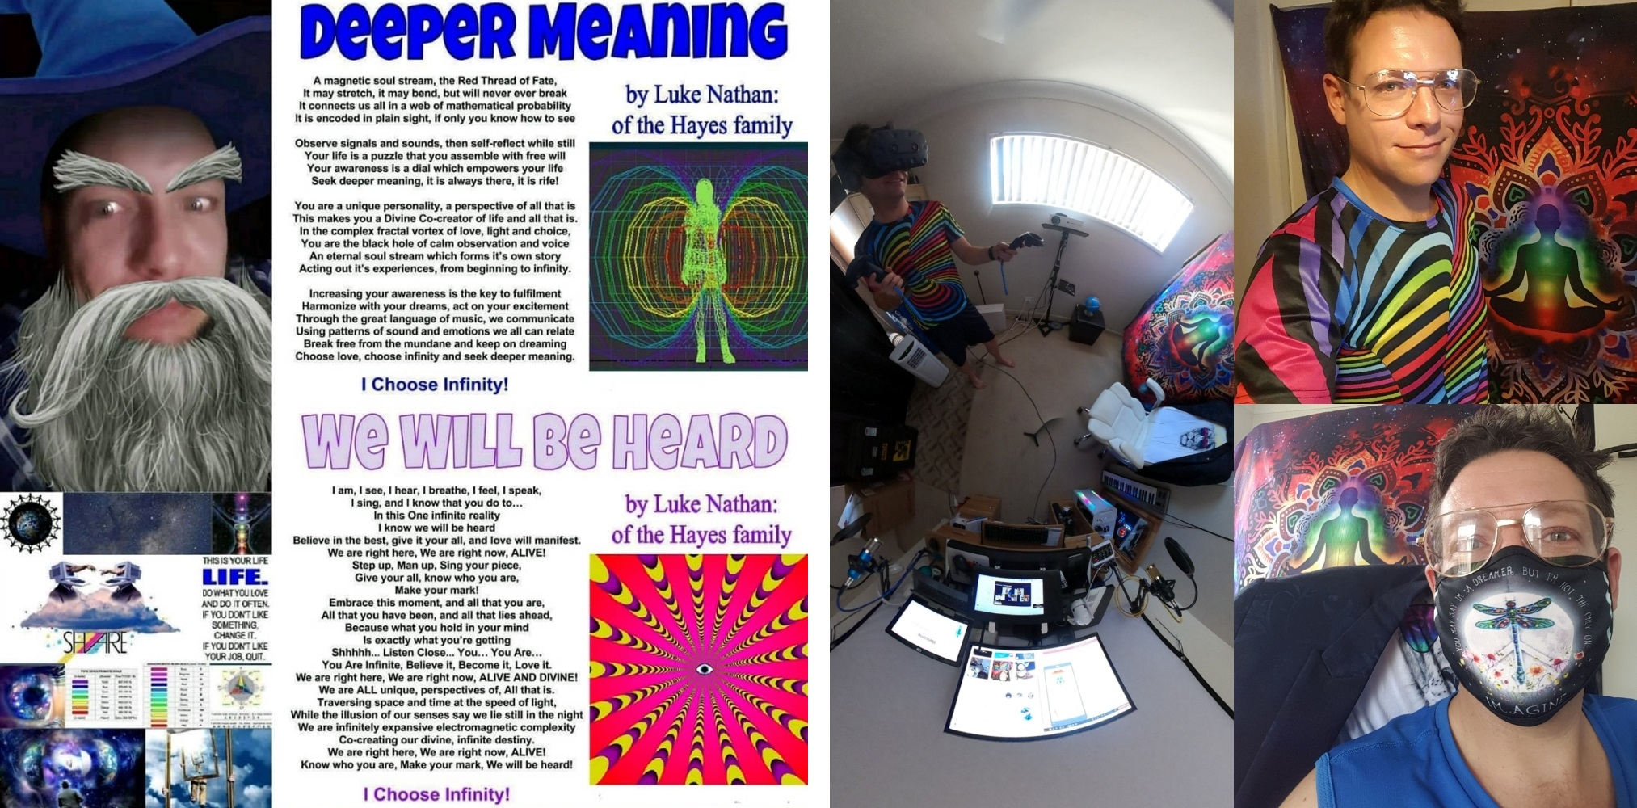


Presentation By
Luke Catalyst Nathan Hayes

